Slide 1
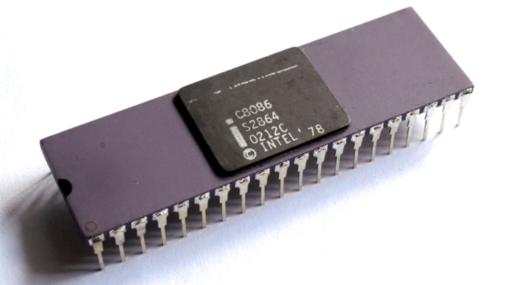
The Processor
Introduction

Slide 2
The Processor
We will construct the datapath and control unit for two different implementations of the MIPS instruction set.
We will be examining an implementation that includes a subset of the core MIPS instruction set:
■ The memory-reference instructions load word (lw) and store word (sw)
■ The arithmetic-logical instructions add, sub, AND, OR, and slt
■ The instructions branch equal (beq) and jump (j)

Slide 3
The Processor
For every instruction, the first two steps are identical:
Send the program counter (PC) to the memory that contains the code and fetch the instruction from that memory.
Read one or two registers, using fields of the instruction to select the registers to read.
Then, it depends on the instruction class (memory-reference, arithmetic-logical, and branches)
The simplicity and regularity of the MIPS instruction set simplifies the implementation by making the execution of many of the instruction classes similar

Slide 4
The Processor
All instruction classes, except jump, use the arithmetic-logical unit (ALU) after reading the registers.
The memory-reference instructions use the ALU for an address calculation
The arithmetic-logical instructions for the operation execution
Branches for comparison

Slide 5
The Processor
After using the ALU, the actions required to complete various instruction classes differ.
A memory-reference instruction will need to access the memory either to read data for a load or write data for a store.
An arithmetic-logical or load instruction must write the data from the ALU or memory back into a register.
Lastly, for a branch instruction, we may need to change the next instruction address based on the comparison; otherwise, the PC should be incremented by 4 to get the address of the next instruction.

Slide 6
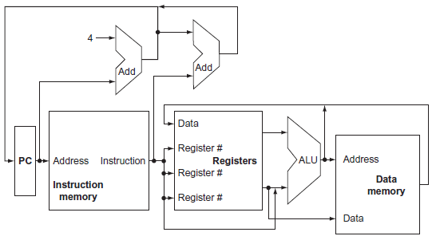
The value written into the PC can come from one of two adders, the data written into the register file can come from either the ALU or the data memory, and the second input to the ALU can come from a register or the immediate field of the instruction.

Slide 7
The data memory must read on a load and written on a store.
The register file must be written only on a load or an arithmetic-logical instruction.
The ALU must perform one of several operations
Notes:
Like the multiplexors, control lines that are set on the basis of various fields in the instruction direct these operations.

Slide 8
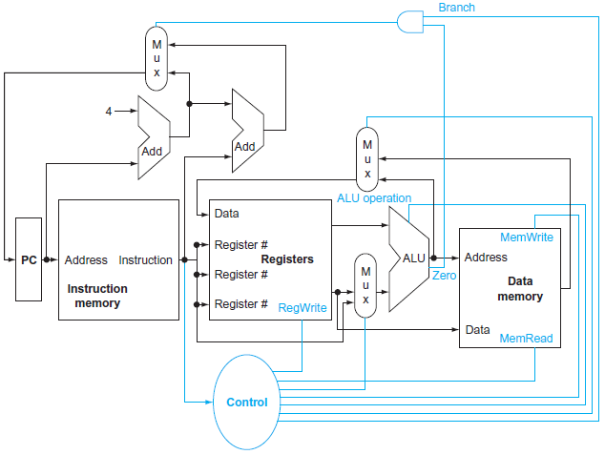
Notes:
We need Control unit and MUX
* The top multiplexor (“Mux”) controls what value replaces the PC (PC + 4 or the branch destination address); the multiplexor is controlled by the gate that “ANDs” together the Zero output of the ALU and a control signal that indicates that the instruction is a branch.
* The middle multiplexor, whose output returns to the register file, is used to steer the output of the ALU (in the case of an arithmetic-logical instruction) or the output of the data memory (in the case of a load) for writing into the register file.
* Finally, the bottommost multiplexor is used to determine whether the second ALU input is from the registers (for an arithmetic-logical instruction or a branch) or from the off set field of the instruction (for a load or store).
* The added control lines are straightforward and determine the operation performed at the ALU, whether the data memory should read or write, and whether the registers should perform a write operation.

Slide 9
Logic Design
The datapath elements in the MIPS implementation consist of two different types of logic elements:
Elements that operate on data values
Elements that contain state
The elements that operate on data values are all combinational, which means that their outputs depend only on the current inputs
Given the same input, a combinational element always produces the same output
The ALU is an example of a combinational element

Slide 10
Logic Design
The datapath elements in the MIPS implementation consist of two different types of logic elements:
Elements that operate on data values
Elements that contain state
Other elements in the design are not combinational, but sequential, in fact they contain state.
An element contains state if it has some internal storage
We call these elements state elements (or sequential)
The instruction and data memories, as well as the registers, are all examples of state elements.
Notes:
Logic components that contain state are also called sequential, because their outputs depend on both their inputs and the contents of the internal state.

Slide 11
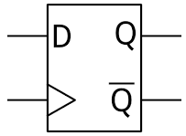
Logic Design
A state element has at least 2 inputs and 1 output
The required inputs are:
The data value to be written into the element
The clock which determines when the data value is written
The output from a state element provides the value that was written in an earlier clock cycle
The clock is used to determine when the state element should be written; a state element can be read at any time.
Notes:
For example, one of the logically simplest state elements is a D-type flip-flop, which has exactly these two inputs (a value and a clock) and one output.

Slide 12
Memory Elements
Let’s discuss the basic principles behind memory elements, starting with flip-flops and latches, moving on to register files, and finishing with memories.
The output from any memory element depends both on:
The inputs
The value that has been stored inside the memory element (the state)
Inputs + State = Output

Slide 13
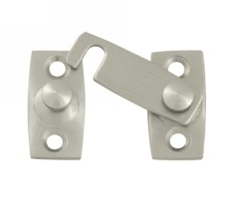
Latches

Slide 14
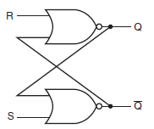
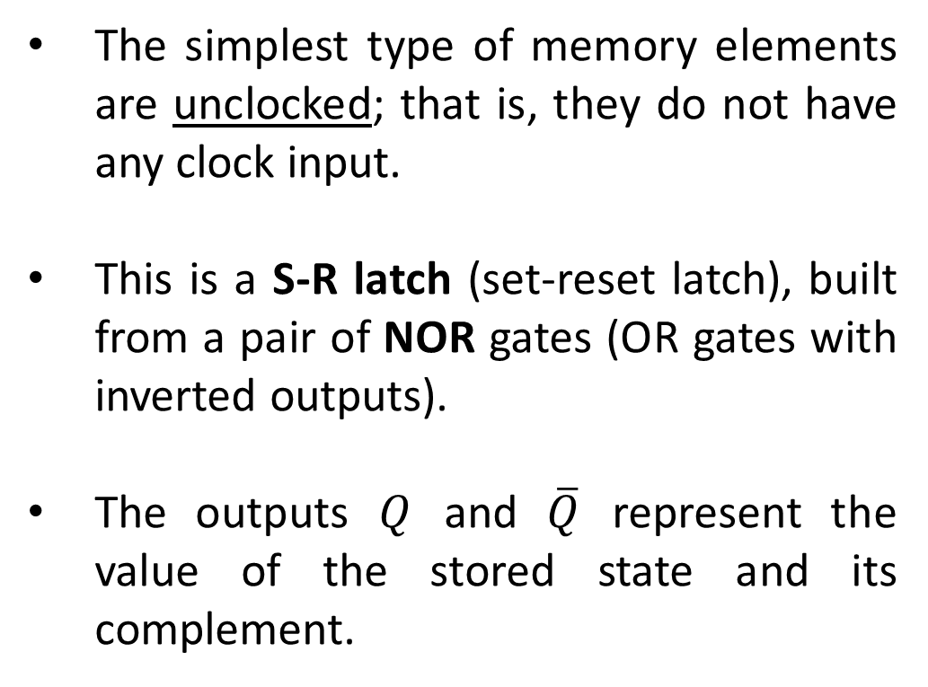
The simplest type of memory elements are unclocked; that is, they do not have any clock input.
This is a S-R latch (set-reset latch), built from a pair of NOR gates (OR gates with inverted outputs).
The outputs $Q$ and $\overline{Q}$ represent the value of the stored state and its complement.

Slide 15
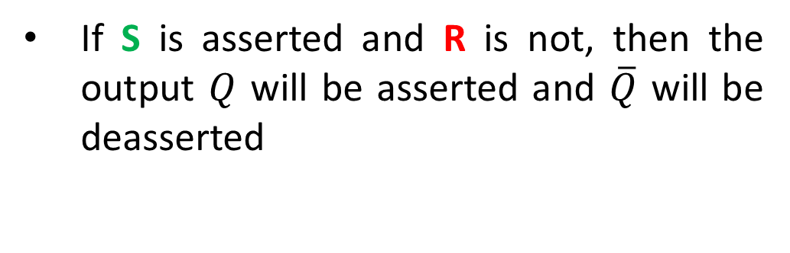
If S is asserted and R is not, then the output $Q$ will be asserted and $\overline{Q}$ will be deasserted
0
0
1
1
1
0
Notes:
This cross-coupled structure is the basis for more complex memory elements that allow us to store data signals.

Slide 16

While if R is asserted and S is not, then the output $\overline{Q}$will be asserted and $Q$ will be deasserted.
1
1
0
0
0
1
Notes:
This cross-coupled structure is the basis for more complex memory elements that allow us to store data signals.

Slide 17
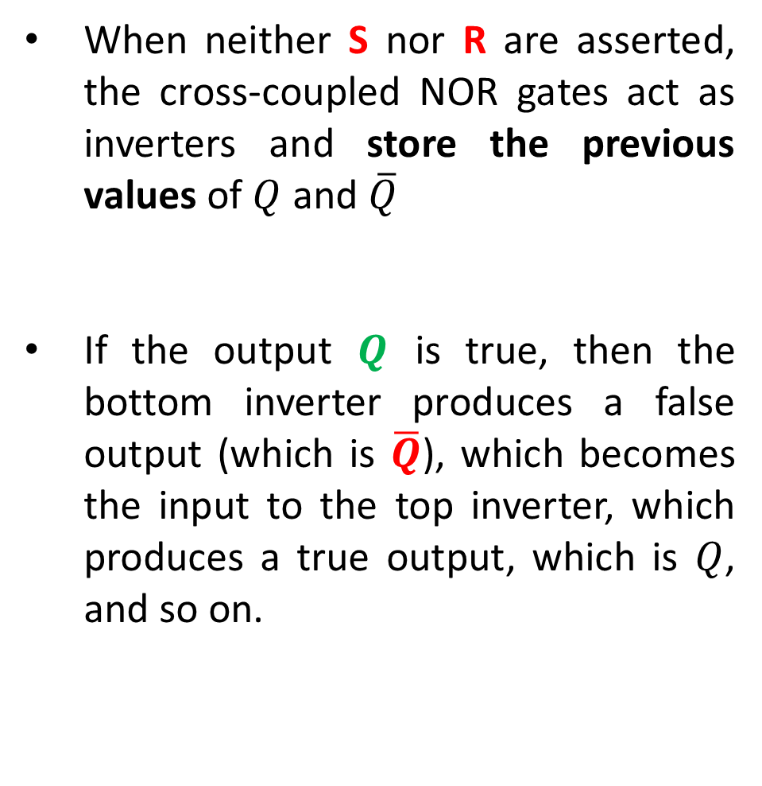
When neither S nor R are asserted, the cross-coupled NOR gates act as inverters and store the previous values of $Q$ and $\overline{Q}$
If the output $Q$ is true, then the bottom inverter produces a false output (which is $\overline{Q}$), which becomes the input to the top inverter, which produces a true output, which is $Q$, and so on.
0
0
1
1
0
0
Notes:
This cross-coupled structure is the basis for more complex memory elements that allow us to store data signals.

Slide 18
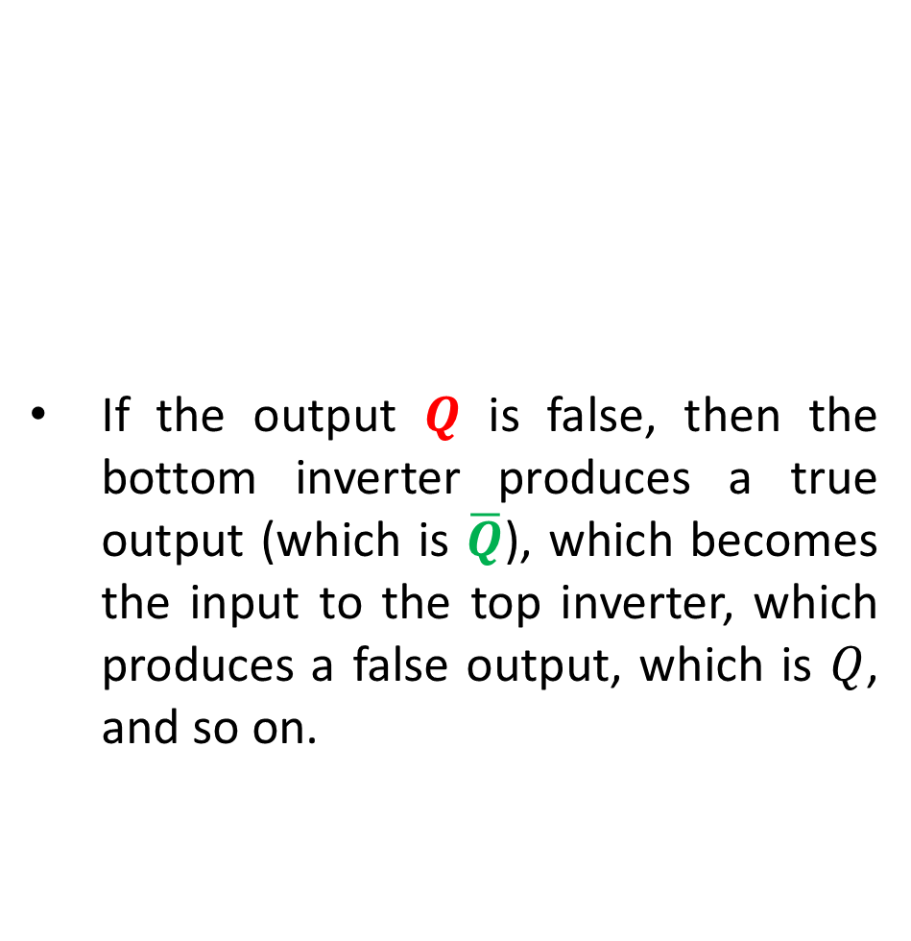
If the output $Q$ is false, then the bottom inverter produces a true output (which is $\overline{Q}$), which becomes the input to the top inverter, which produces a false output, which is $Q$, and so on.
0
1
0
0
0
1
Notes:
This cross-coupled structure is the basis for more complex memory elements that allow us to store data signals.

Slide 19
Asserting S and R simultaneously can lead to incorrect operation: depending on how S and R are deasserted, the latch may oscillate or become metastable
Notes:
This cross-coupled structure is the basis for more complex memory elements that allow us to store data signals.

Slide 20

Flip-flop and Latches
Unlike the S-R latch described before, all the latches and flip-flops we will use from this point on are clocked, which means that they have a clock input and the change of state is triggered by that clock.

Slide 21
Flip-flop and Latches
The difference between a flip-flop and a latch is the point at which the clock causes the state to actually change.
In a clocked latch, the state is changed whenever the appropriate inputs change and the clock is asserted
Whereas in a flip-flop, the state is changed only on a clock edge

Slide 22
Flip-flop and Latches
Because we use an edge-triggered timing methodology where state is only updated on clock edges, we need only use flip-flops
Flip-flops are often built from latches, so we start by describing the operation of a simple clocked latch and then discuss the operation of a flip-flop constructed from that latch.

Slide 23
Flip-flop and Latches
A D latch or D flip-flop stores the value of its data input signal in the internal memory
Although there are many other types of latch and flip-flop, the D type is the only basic building block that we will need.
A D latch has 2 inputs and 2 outputs.

Slide 24
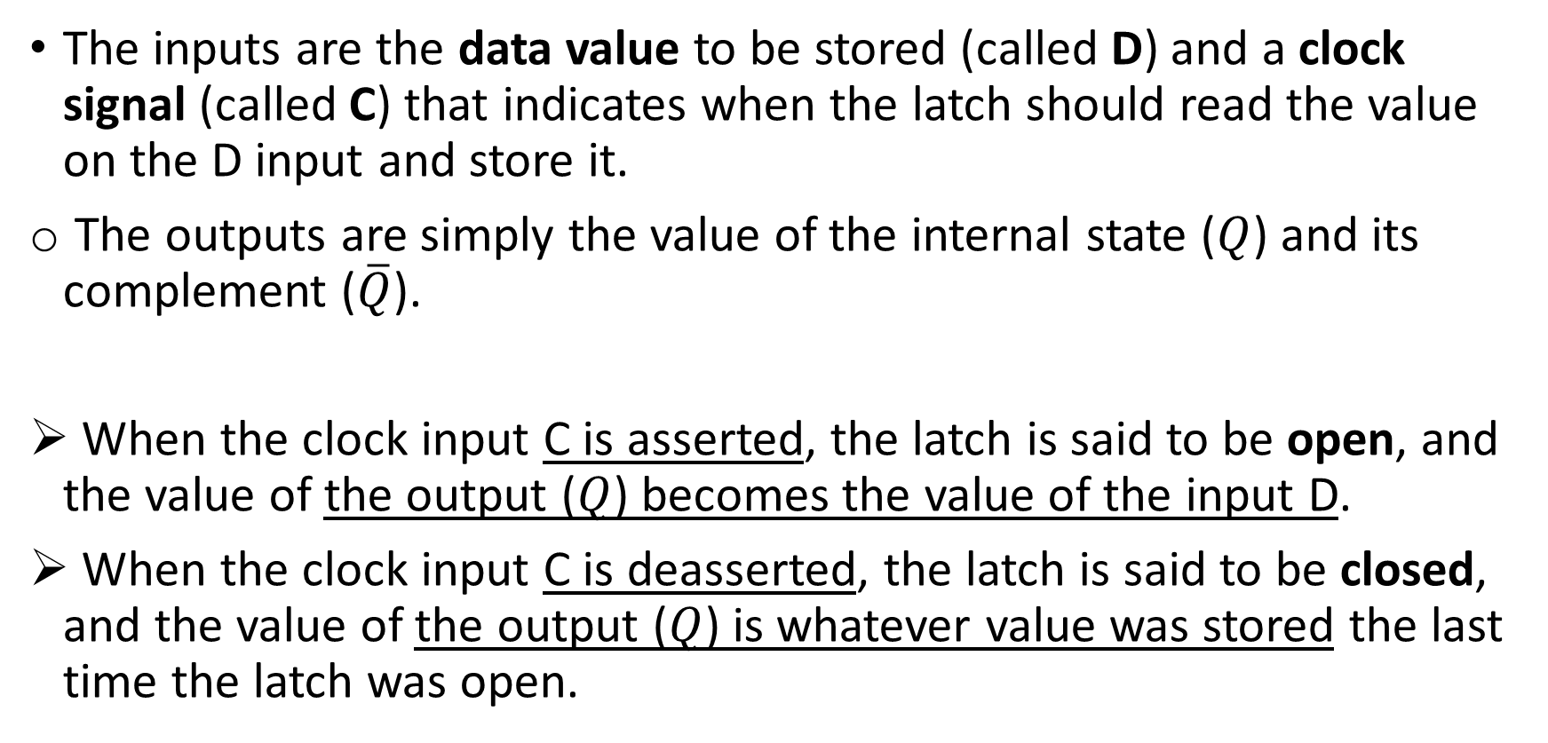
Flip-flop and Latches
The inputs are the data value to be stored (called D) and a clock signal (called C) that indicates when the latch should read the value on the D input and store it.
The outputs are simply the value of the internal state ($Q$) and its complement ($\overline{Q}$).
When the clock input C is asserted, the latch is said to be open, and the value of the output ($Q$) becomes the value of the input D.
When the clock input C is deasserted, the latch is said to be closed, and the value of the output ($Q$) is whatever value was stored the last time the latch was open.

Slide 25
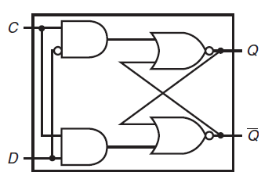
The figure shows how a D latch can be implemented with two additional gates added to the cross-coupled NOR gates.
0
0
0
0
1
0
0
0
0
1
1
1
Notes:
Add two gates to the latch that we saw before
Since when the latch is open the value of Q changes as D changes, this structure is sometimes called a transparent latch.

Slide 26
The figure shows how a D latch can be implemented with two additional gates added to the cross-coupled NOR gates.
1
1
0
0
1
0
0
1
0
1
1
1
1
1
1
0
Notes:
Add two gates to the latch that we saw before
Since when the latch is open the value of Q changes as D changes, this structure is sometimes called a transparent latch.

Slide 27
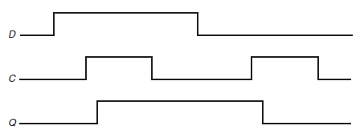
D changes from 0 to 1. Q is still 0 because the clock is still 0
C changes from 0 to 1. Q and D are still 0 because there is a delay (given by the gates)
Q finally changes from 0 to 1. All signals are 1.
The figure below shows how this D latch works, assuming that the output Q is initially false and that D changes first.
Notes:
Add two gates to the latch that we saw before
Since when the latch is open the value of Q changes as D changes, this structure is sometimes called a transparent latch.

Slide 28
D changes from 1 to 0. Q is still 1 because the clock is 0
C changes from 0 to 1. Q is still 1 and C is still 0
Q finally changes from 1 to 0.
Notes:
Add two gates to the latch that we saw before
Since when the latch is open the value of Q changes as D changes, this structure is sometimes called a transparent latch.

Slide 29
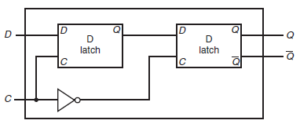
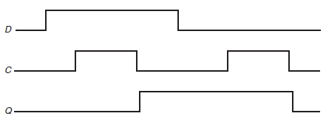
Flip-flops outputs change only on the clock edge.
A flip-flop can be built so that it triggers on either the rising (positive) or falling (negative) clock edge; for our designs we can use either type.
The figure above shows how a falling-edge D flip-flop is constructed from a pair of D latches
In a D flip-flop, the output is stored when the clock edge occurs.
1
0
0
1

Slide 30
1
1
0
1
0

Slide 31
1
1
1
0
1

Slide 32
0
1
1
0
1

Slide 33
0
0
1
1
0

Slide 34
0
0
0
0
1

Slide 35
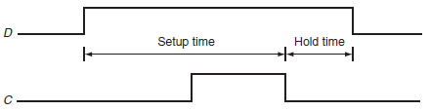
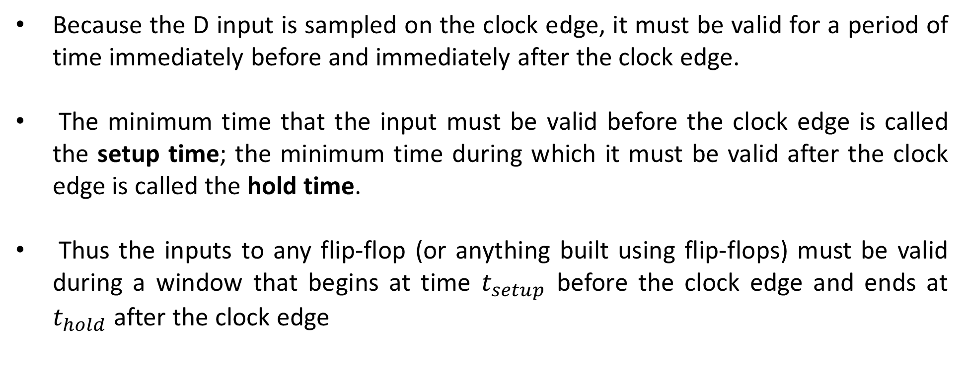
Because the D input is sampled on the clock edge, it must be valid for a period of time immediately before and immediately after the clock edge.
The minimum time that the input must be valid before the clock edge is called the setup time; the minimum time during which it must be valid after the clock edge is called the hold time.
Thus the inputs to any flip-flop (or anything built using flip-flops) must be valid during a window that begins at time $t_{setup}$ before the clock edge and ends at $t_{hold}$ after the clock edge

